Slide 1
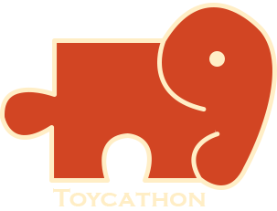
CleaniToon
Cleanliness is truly Child's Play

Slide 2
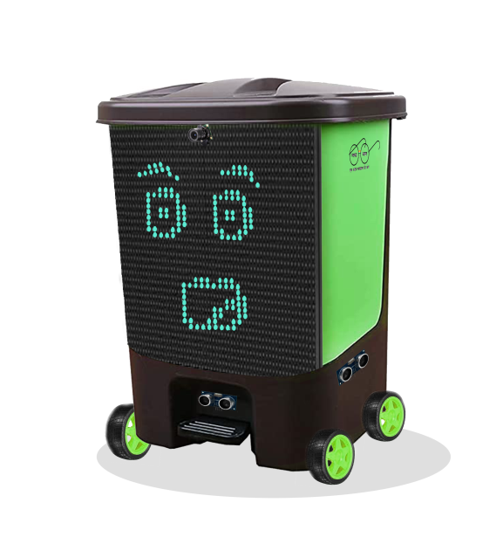
ABOUT YOUR TOY IDEA
Our Toy would be ML & AI based, that would roam freely in home (autonomously), looking for household garbage. Toy would use LED display and Sound system to keep child engaged and would teach good habits at subconscious level. Using this Toy we are trying to inculcate human values in children through recreational activity.
Overview of Idea
The (ML-AI based) BOT would be designed to roam autonomously in the home playing Joyful Rhymes until it detects some garbage (coiled paper, (toy) block-pieces, wrapper) and when detected BOT would provoke the child to dispose the garbage in the dustbin, once done the BOT would appraise the child for his good deeds.
Teaching good things in the initial phase of life develops good personality and thus future’s great citizens. Childhood Phase is the best time to inculcate moral ethics and good habits. Our team has come up with an idea of teaching the importance of cleanliness with recreational activities. Taking SWACHH BHARAT ABHIYAN to a different level and trying to make it a second nature for people, through early teachings.
We have intentionally kept the Design for BOT same as of an DUSTBIN. Because we want to change the basic perspective of people for Dustbin as a Dirty Place (Bad) to something that is a basic part of our life, a Good thing that keeps other places Clean and Healthy.
Other features for BOT involve teaching English-Alphabets, Hindi-Varna-Mala, Number-Counting using LED-Display. Modes can be switched using buttons.
Schema Select
1
Physical Toy
2
Social and Humal Values
(Swachh Bharat Abhiyan)

Slide 3
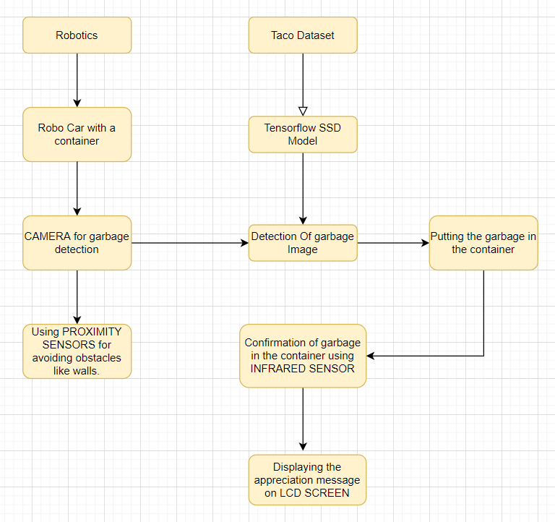
Your Approach towards Idea Development
Building prototype :
Making image and video design of prototype using advance graphic tools.
Gathering information of components required and estimating best budget components to be used.
Making circuit analysis using software.
Training ML software using datasets.
Assemble prototype and start experimenting it to finds bugs.
Removal of bugs.
After getting funded we will start on the actual product planning it to build on large scale.

Slide 4
Create your Toy story
1
How Your Toy is Different From Existing Toys
Difference of our toy with existing product:
Our toy is based on ML & AI which is very rare in market.
It is not just fun based Toy, but it will help developing good habits in children through recreational activities.
Using it we will be promoting Swachh Bharat Abhiyan nation-wide, amongst coming youth.
Design of Toy will be kept highly eye catching for kids.
Commercializing:
Our Toy is based on the Ideology of Swachh Bharat Abhiyan, therefore we could use it to make it nation sensation.
Two products will be developed, one will be premium variant as it will be rich in User-Interface (LED-Display) and have other learning modes associated with it.
Second variant will be on cheaper side targeting families of lower wages background.
2
Does Your Toy Reflect Indian Culture, Ethos, Ayurveda, Diversity or Psychology
Yes, our toy reflect the Indian Culture and Ethos of cleanliness.
Our toy inculcate good habit of cleaning it's surrounding from childhood. This will create a good outlook towards labour who clean our surrounding.
Some added features in our bot will teach child poems , alphabets etc. From childhood. This will help in developing good habit from early childhood.

Slide 5
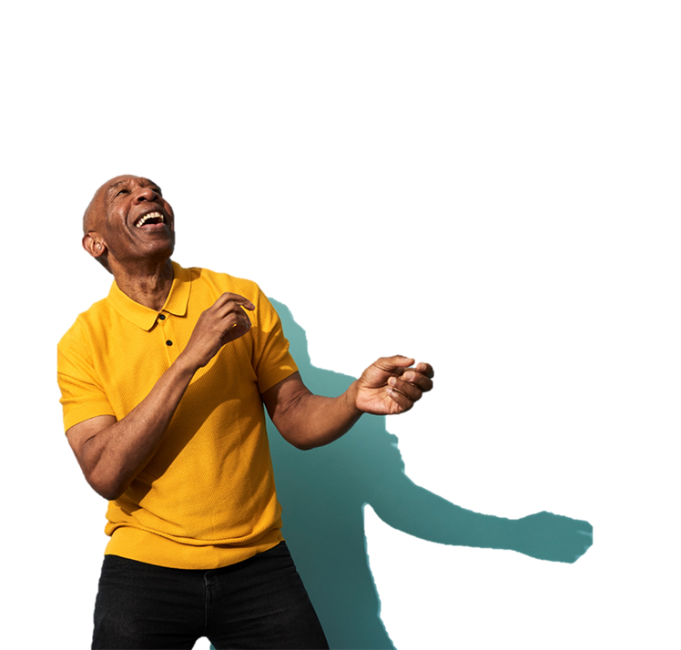
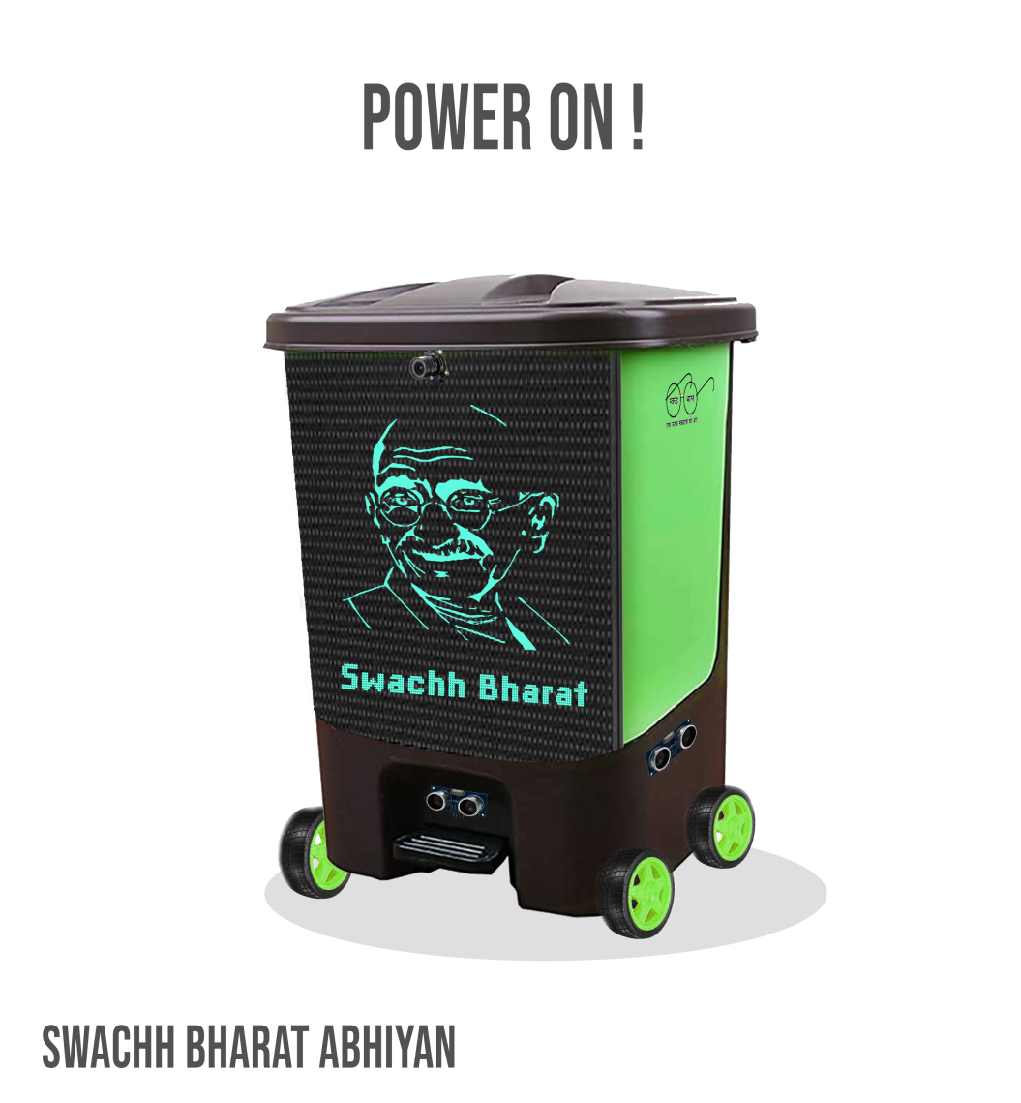
SOME CREATIVES
We have intentionally kept the Design for BOT same as of an DUSTBIN.
Because we want to change the basic perspective of people for Dustbin as a Dirty Place (Bad) to something that is a basic part of our life, a (Good) thing that keeps other places Clean and Healthy.

Slide 6
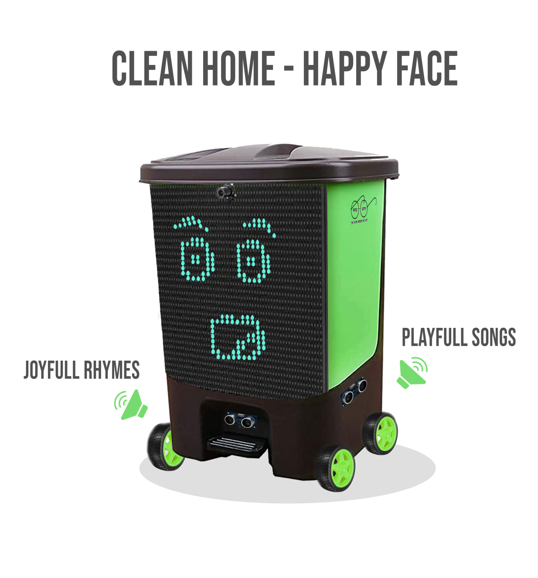
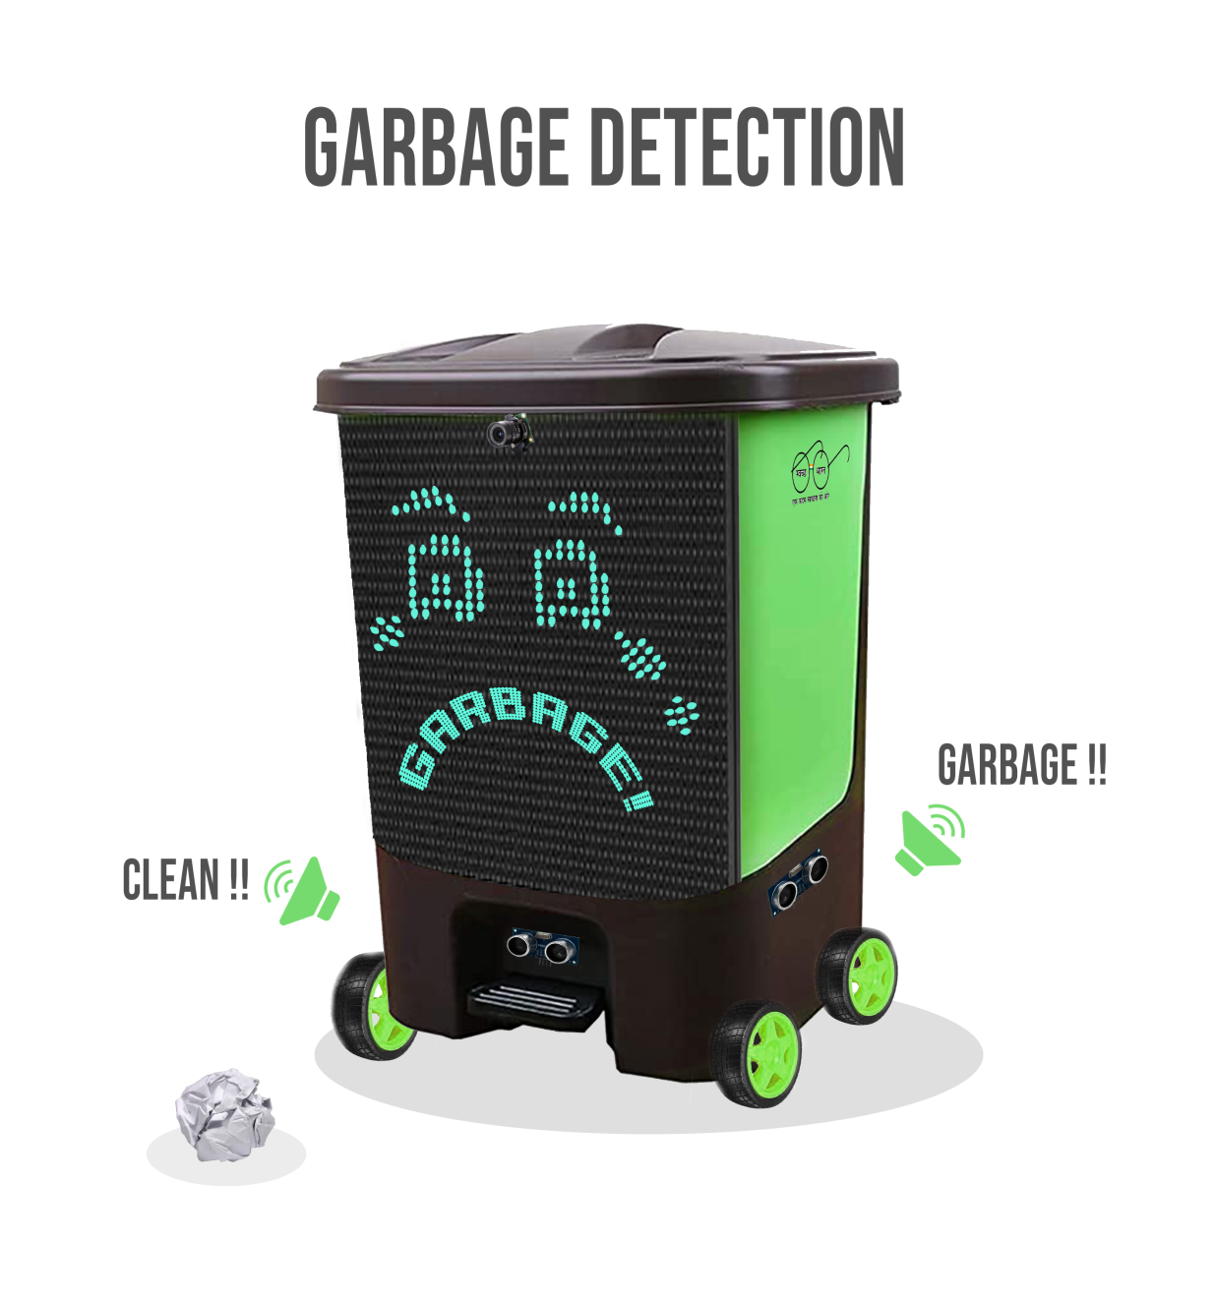

Slide 7
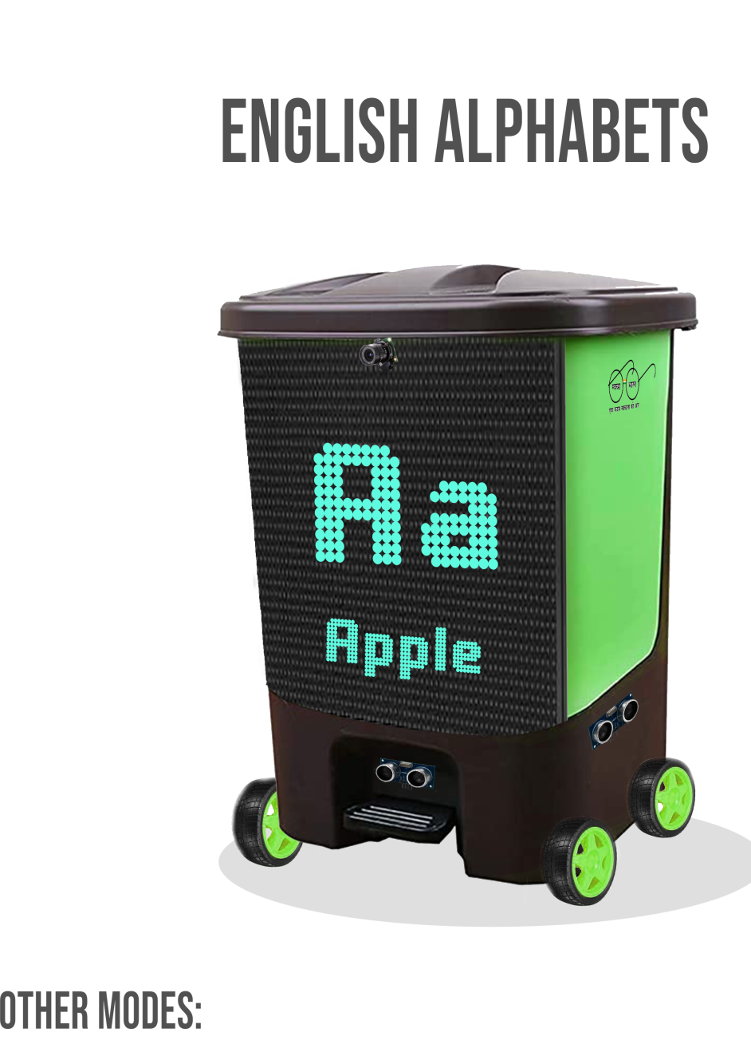

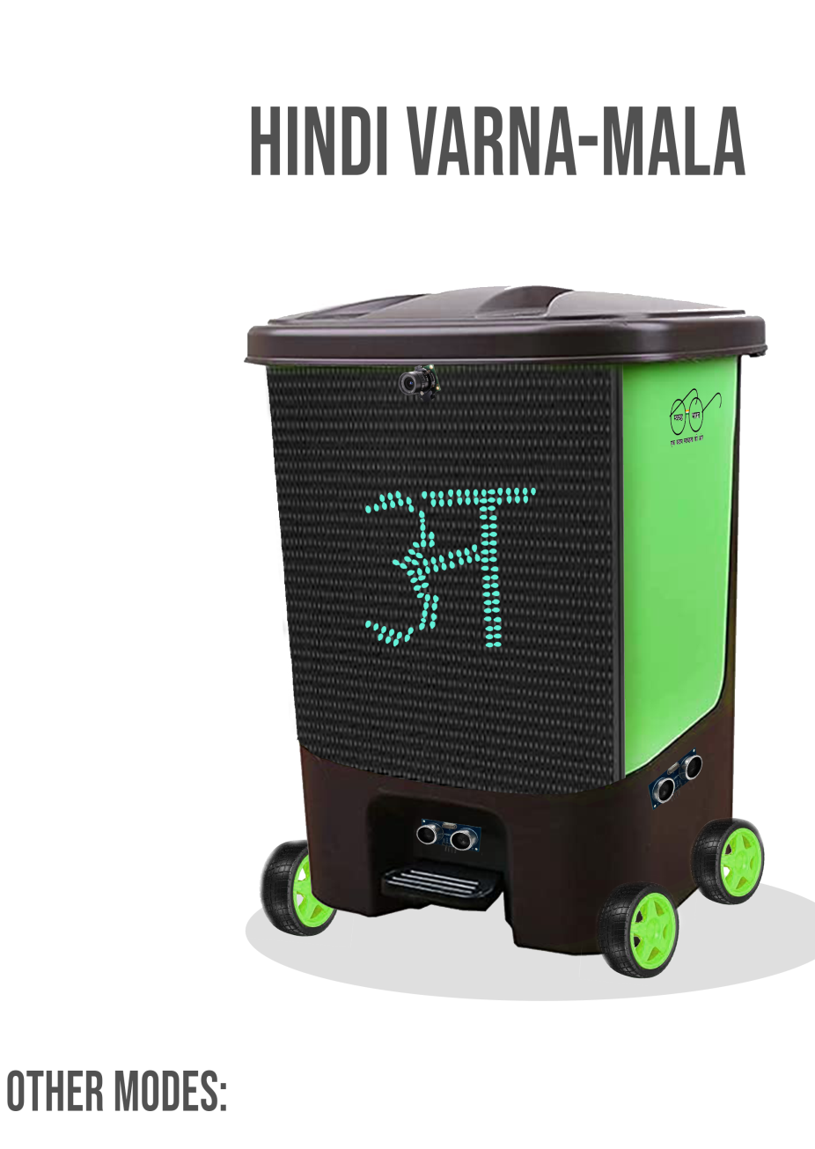

Slide 8
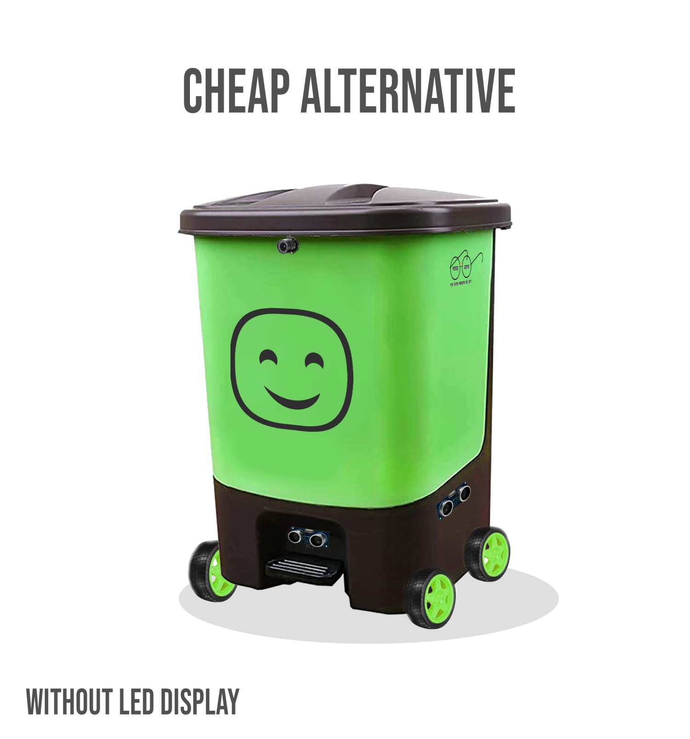
We understand that the Product can cross the normal budget for toys. Therefore we have come up with a cheap and efficient Alternative that is the same BOT without LED Display. Keeping the same level of interaction using Sound Systems.

Slide 9
Team Profile
Team Objective
Our team has came up with this IDEA to build a simple recreational Toy (using complex technical knowledge) to inculcate human values in children and making it theirs second nature. Sidewise, promoting Swachh Bharat Abhiyan amongst coming Youth and expanding Toy Market in India.
CleaniToon
Team Details
Dr. Sachin Tripathi (Mentor) sachin2781@iitism.ac.in 9471191359
(Associate Professor & Head Department of Computer Science & Engineering, Institute TEQIP Coordinator)
Aman Harsh (L) aman.harsh.1451@gmail.com 7879535412
Aman Kumar aman.19je0105@mc.iitism.ac.in 7091580114
Alok Kumar alok.19je0100@cse.iitism.ac.in 9558188930
Akshay Kumar Saunta aksmasih003@gmail.com 7908299028
Gyanendra Das gyanendralucky9337@gmail.com 7735546362
Team Size: 5
Mentors: 1
IIT (ISM) Dhanbad
Type: HEI's Students

